Slide 1



VOIS Innovation
Marathon 2.0

Slide 2


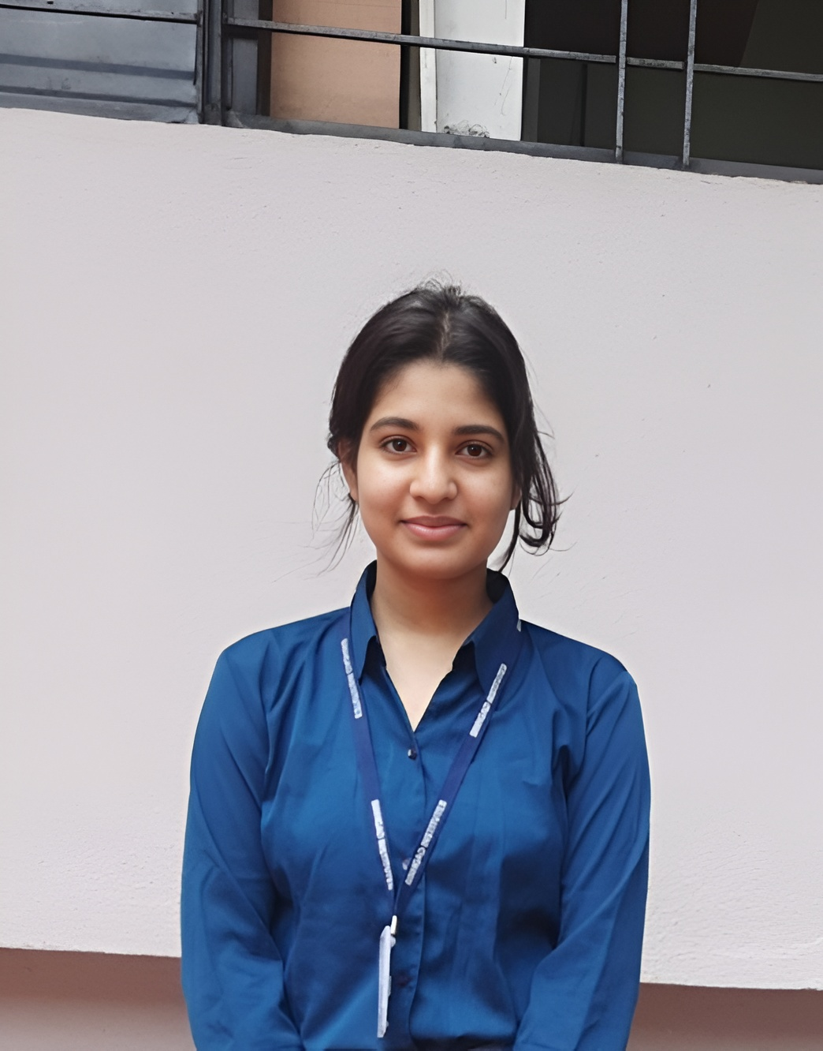
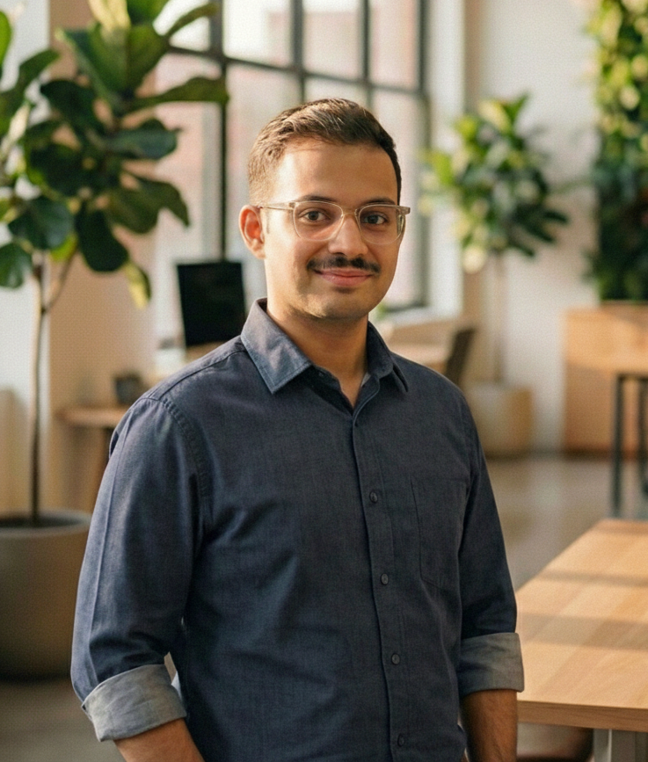
NyaySetu AI – Legal Assistance for Every Citizen
Insert your professional photo
Mr. Shivraj Taware.
Information Technology
Team No. 43
Team Lead, Name, Branch
Sinhgad Academy of Engineering, Pune – 48, Maharashtra
Miss. Pragyata Singh.
Information Technology
Mr. Prasad Paigude.
Information Technology

Slide 3

Problem Statement
NyaySetu AI – Legal Assistance for Every Citizen
The Challenge: India’s legal system is strong — but inaccessible to the common citizen. The challenge is not the absence of laws, but the difficulty in understanding, affording, and navigating them.
Low Legal Literacy - Complex legal language makes it hard for citizens to understand rights, laws, and procedures, especially in rural and semi-urban areas.
Limited Access to Legal Help - Legal help is costly and scarce, while existing legal aid resources are insufficient to meet population-scale demand.
Error-Prone Procedures - Drafting documents like RTIs, Affidavit is manual and unforgiving — small mistakes lead to delays or rejection.
Lack of Timely Legal Awareness - Citizens struggle to stay updated with new laws, amendments and regulations, often relying on outdated information.
Without a reliable, intelligent legal assistant, citizens spend excessive time navigating legal uncertainty, make avoidable mistakes, and often fail to exercise their rights effectively — resulting in delayed justice, financial loss, and reduced trust in the legal system.

Slide 4

Need of Project
Despite India having a well-established legal framework, access to justice remains broken at the citizen level.
Low legal literacy prevents citizens from understanding their rights and legal procedures
High consultation costs make professional legal help inaccessible for many
Frequent documentation errors lead to rejection, delays, and repeated filings
Lack of reliable, up-to-date information forces citizens to depend on outdated or incorrect sources.
These gaps highlight the urgent need for a simple, affordable, and trustworthy legal assistance system.
JUSTICE EXISTS — BUT ACCESS, UNDERSTANDING, AND EXECUTION REMAIN OUT OF REACH FOR MILLIONS.
THIS IS THE GAP NYAYSETU AI IS BUILT TO BRIDGE.

Slide 5

Proposed Solution
NyaySetu AI is a controlled, AI-driven legal assistance platform designed to make Indian laws understandable, actionable, and usable for every citizen.
The solution provides:
Plain-language explanation of laws and legal documents to improve legal understanding
Intelligent incident analysis to map user situations to relevant legal sections
Automated legal document drafting to reduce procedural errors and rejections
Real-time guidance, ensuring accessibility for diverse users
Secure and controlled handling of legal documents, ensuring trust and reliability
By combining Agentic AI, GenAI, and structured workflows, NyaySetu AI enables citizens to understand their rights, take correct legal action, and execute procedures confidently — without immediate dependence on legal professionals.

Slide 6

Solution Overview
NyaySetu AI is an end-to-end, AI-powered legal assistance platform that transforms complex legal systems into simple, guided, and executable workflows for citizens.
It works by:
Understanding user problems through natural language, enabling citizens to describe their situation naturally and without legal expertise
Explaining applicable laws and legal sections in clear, plain, citizen-friendly language, removing complexity and legal jargon
Predicting relevant legal provisions by analyzing incident descriptions and mapping them to appropriate legal sections with contextual explanation
Automating legal document drafting using structured, validated templates to minimize errors, rejections, and procedural delays
Guiding users step-by-step through legal processes, ensuring correct execution and informed decision-making at every stage
NyaySetu AI turns legal uncertainty into clear, guided, and executable workflows.

Slide 7

Technology used
NyaySetu AI is built using a modular, scalable, and controlled AI architecture, combining modern AI tools with reliable backend systems.
Core Technologies:
Frontend: Next.js, no code/low code platforms (user-friendly, responsive interface)
Backend: Python, Flask / FastAPI (secure and lightweight APIs), Render, Vercel, Github
AI & LLMs: OpenRouter, LLM (meta-llama/Llama-3.1-8B-Instruct), Embedding model (text-embedding-3-small)
Vector Database: ChromaDB (semantic legal retrieval)
Automation & Orchestration: LangChain, n8n
Storage: MongoDB, Google Sheets
Security: Blockchain (Python), Google Authentication
This technology stack ensures accuracy, reliability, scalability, and responsible AI usage — suitable for real-world legal applications.

Slide 8
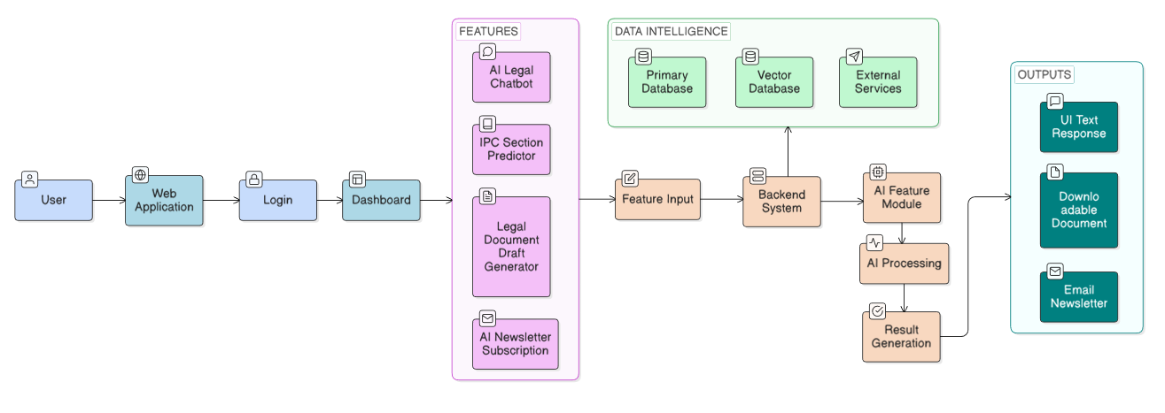
Technical flow diagram -

Slide 9
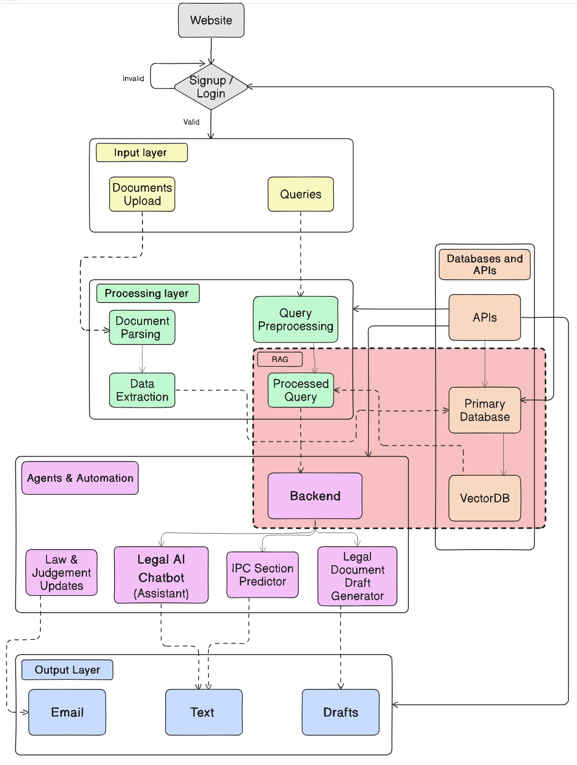
Architecture Blueprint

Slide 10
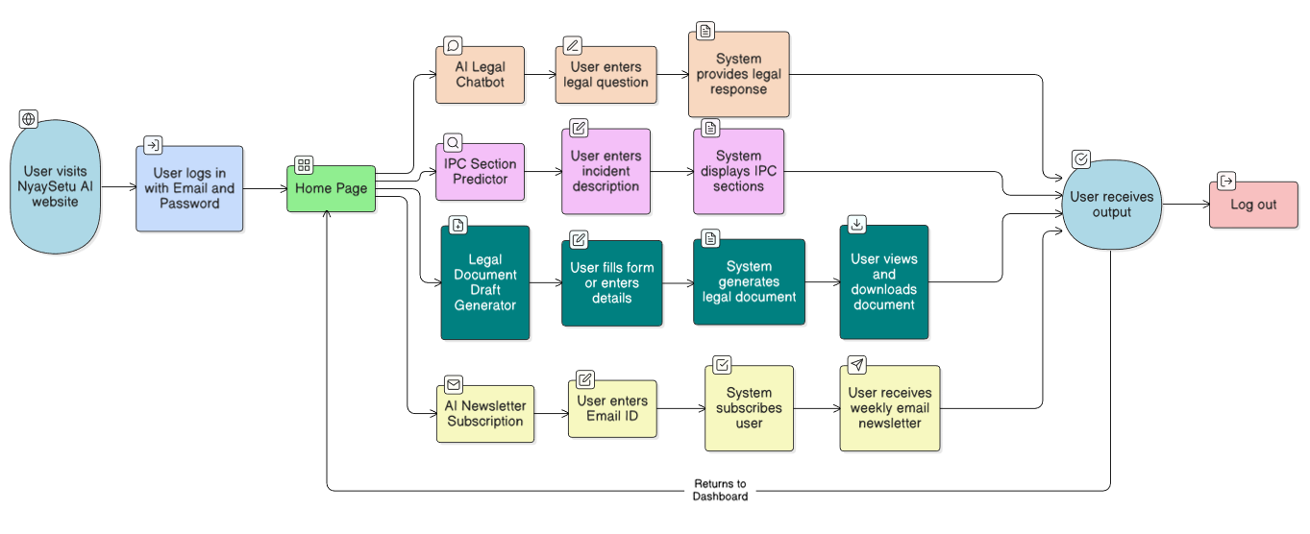
Workflow diagram

Slide 11
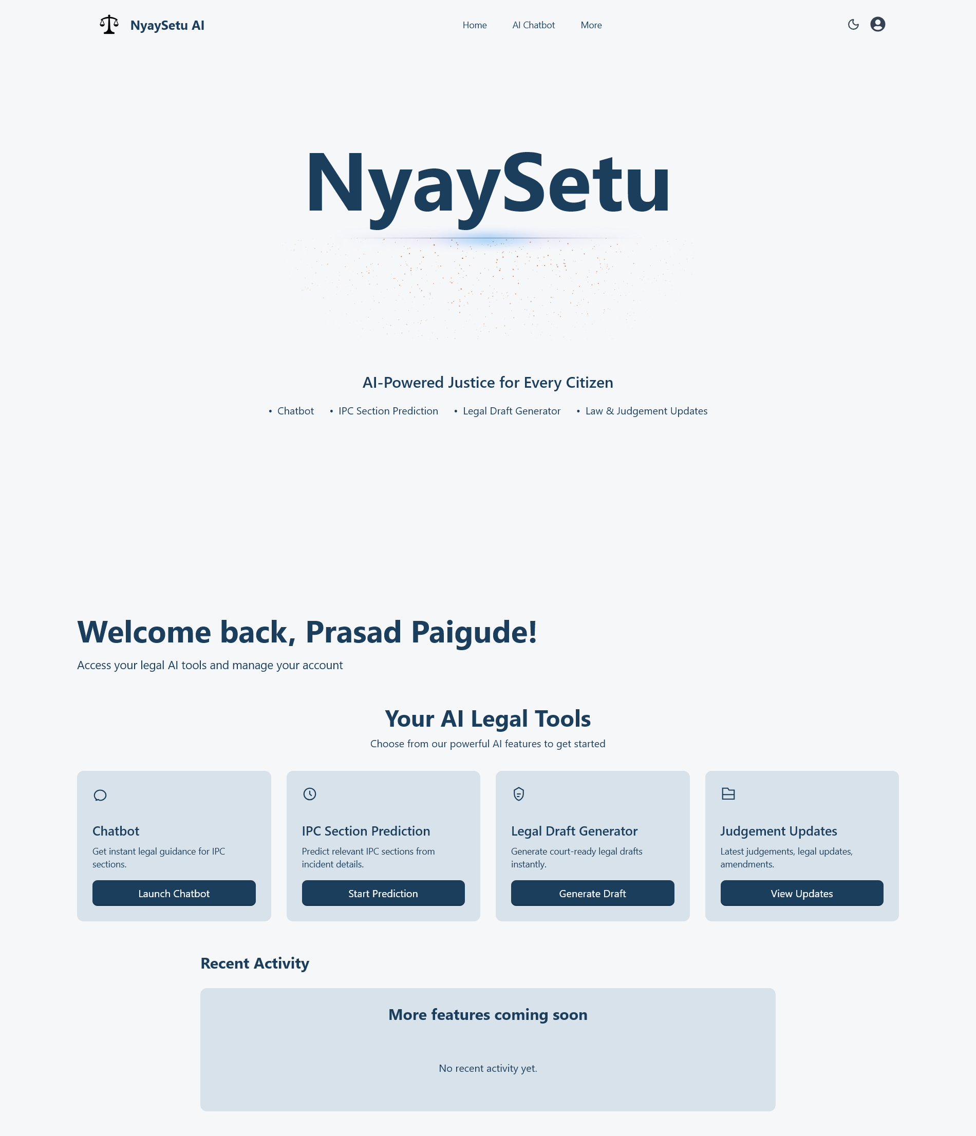
Screen shots of our project -

Slide 12
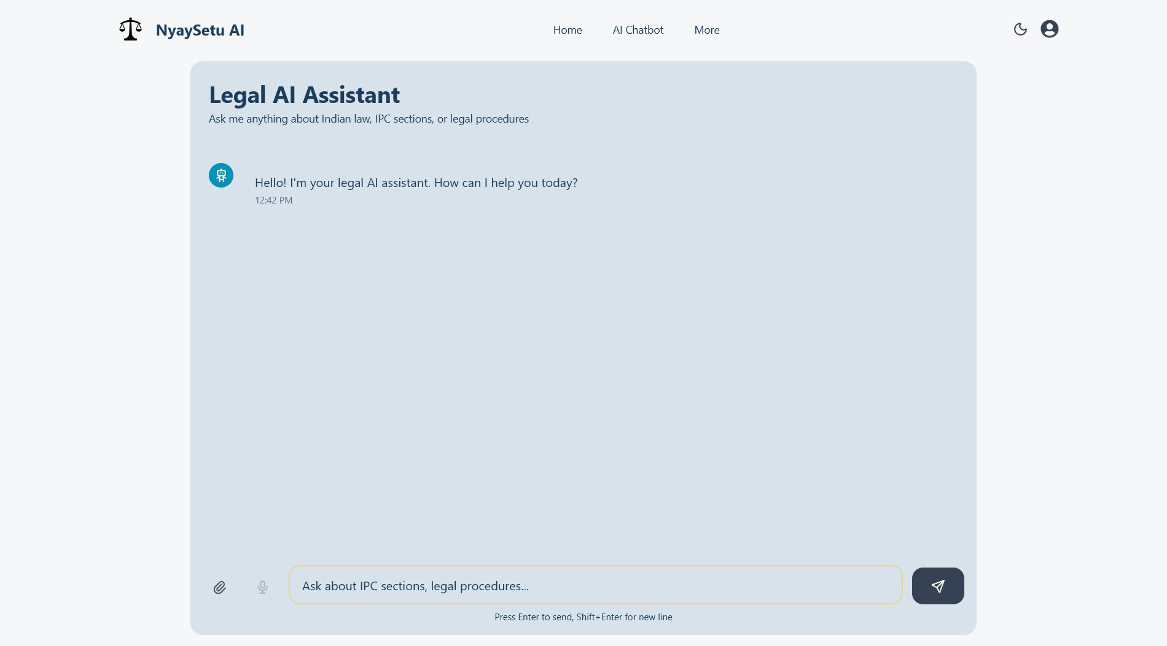
Screen shots of our project -

Slide 13
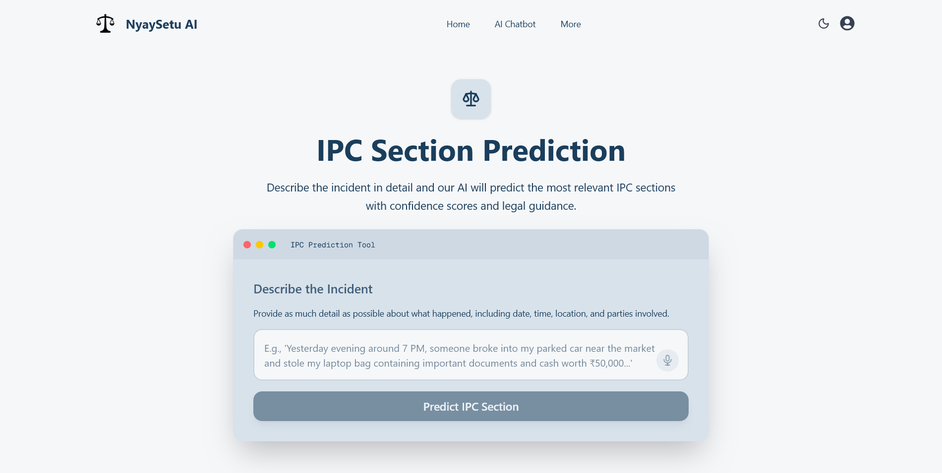
Screen shots of our project -

Slide 14
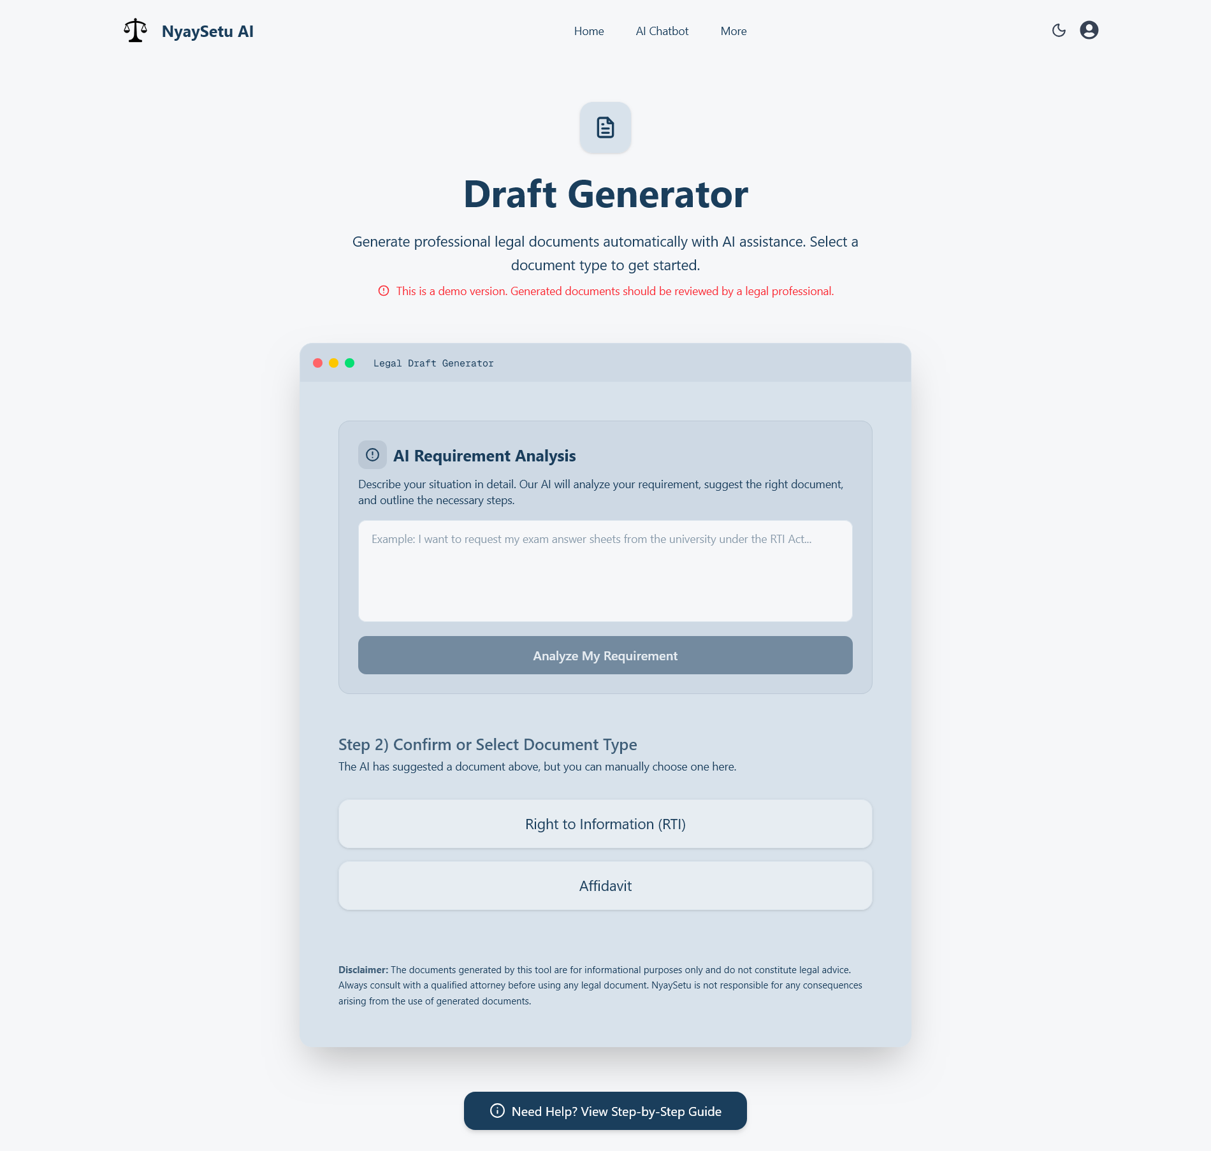
Screen shots of our project -

Slide 15
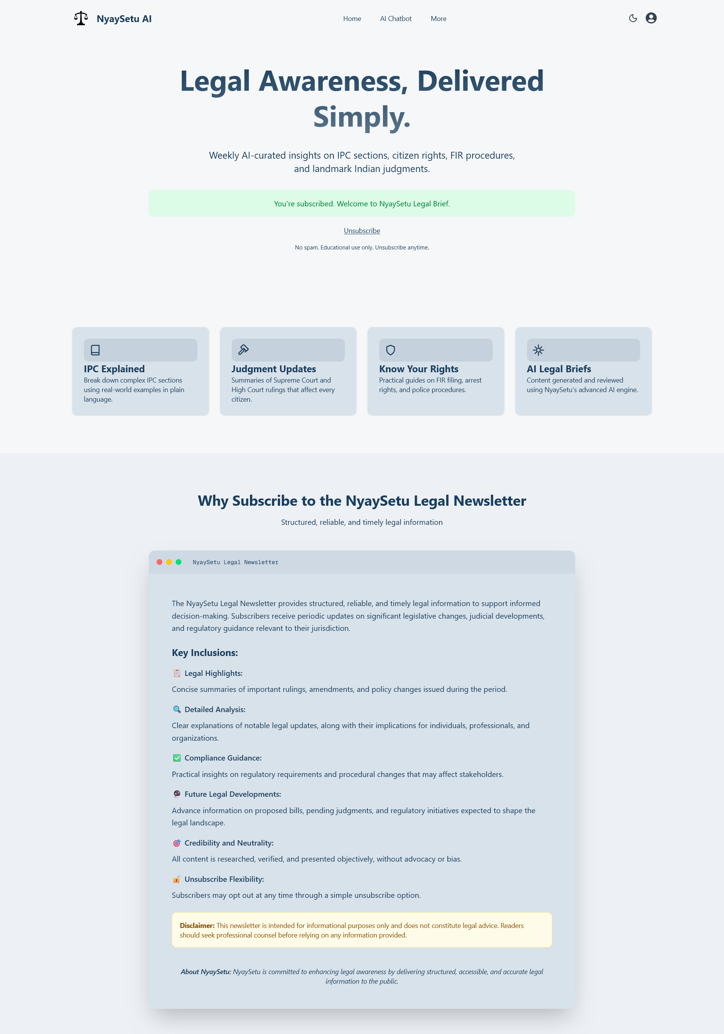
Screen shots of our project -

Slide 16
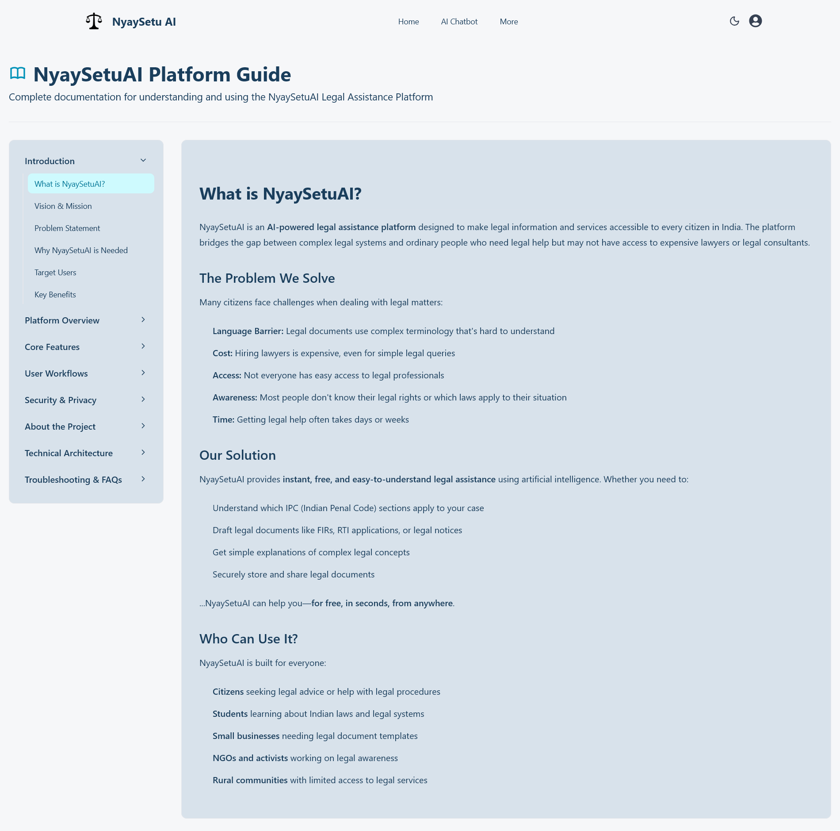
Screen shots of our project -

Slide 17

Role of Agentic AI and Gen AI in the solution
Role of GenAI
Simplifies legal concepts and IPC sections into plain, understandable language
Powers legal Q&A, IPC section prediction, and legal document drafting
Enables accurate, user-friendly legal assistance through text-based interactions
Role of Agentic AI
Used only in the AI Newsletter feature
Automatically fetches, summarizes, and curates legal updates
Schedules and delivers weekly newsletters without manual intervention
Combined Impact
GenAI enables interactive legal assistance, while Agentic AI ensures fully automated legal awareness, together delivering a reliable, scalable, and citizen-centric solution.

Slide 18
Novelty and Uniqueness
1
2
3
4
Citizen-First Legal Simplification:
Converts complex laws and IPC sections into plain, easy-to-understand language.
Incident-to-Law Mapping:
Maps real-life incident descriptions to relevant IPC sections intelligently.
Automated Legal Draft Generation:
Creates ready-to-use legal documents from simple user inputs.
Fully Automated Legal Awareness:
Delivers weekly legal updates via Agentic AI-powered newsletters.

Slide 19
Git Hub Link
Please create public GitHub repository (Enable Add README button while creating repository)
with format:
GitHub URL – https://github.com/shivraj110504/NyaySetu-Prod

Slide 20

Future Scope
NyaySetu AI is built on a scalable, forward-looking architecture, enabling continuous expansion with India’s evolving legal ecosystem.
Expand datasets to include BNS and BNSS, along with updated legal provisions and interpretations
Extend legal coverage to additional laws, state-specific regulations, and regional languages
Enhance AI explainability for clearer, more transparent, and trustworthy legal guidance
Strengthen blockchain-based verification for tamper-proof legal document security
Adopt more efficient AI models to improve accuracy, scalability, and accessibility
Enable personalized legal insights based on user history and context (privacy-aware)
Add voice-based input and output for improved accessibility and ease of use
Enable multilingual support to serve users across diverse linguistic backgrounds

Slide 21
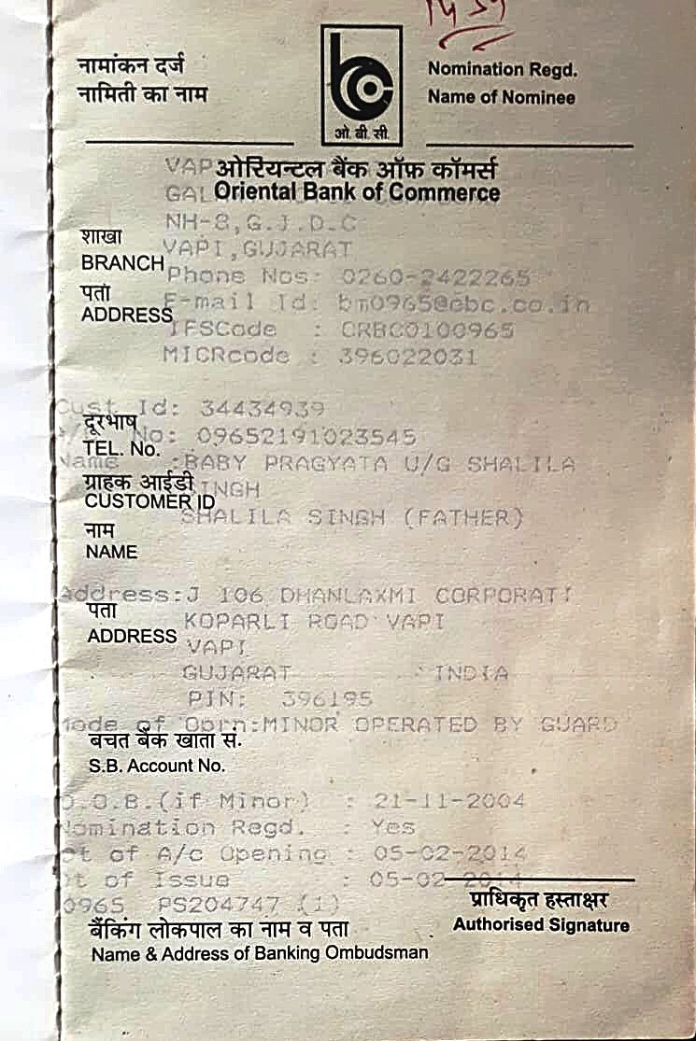
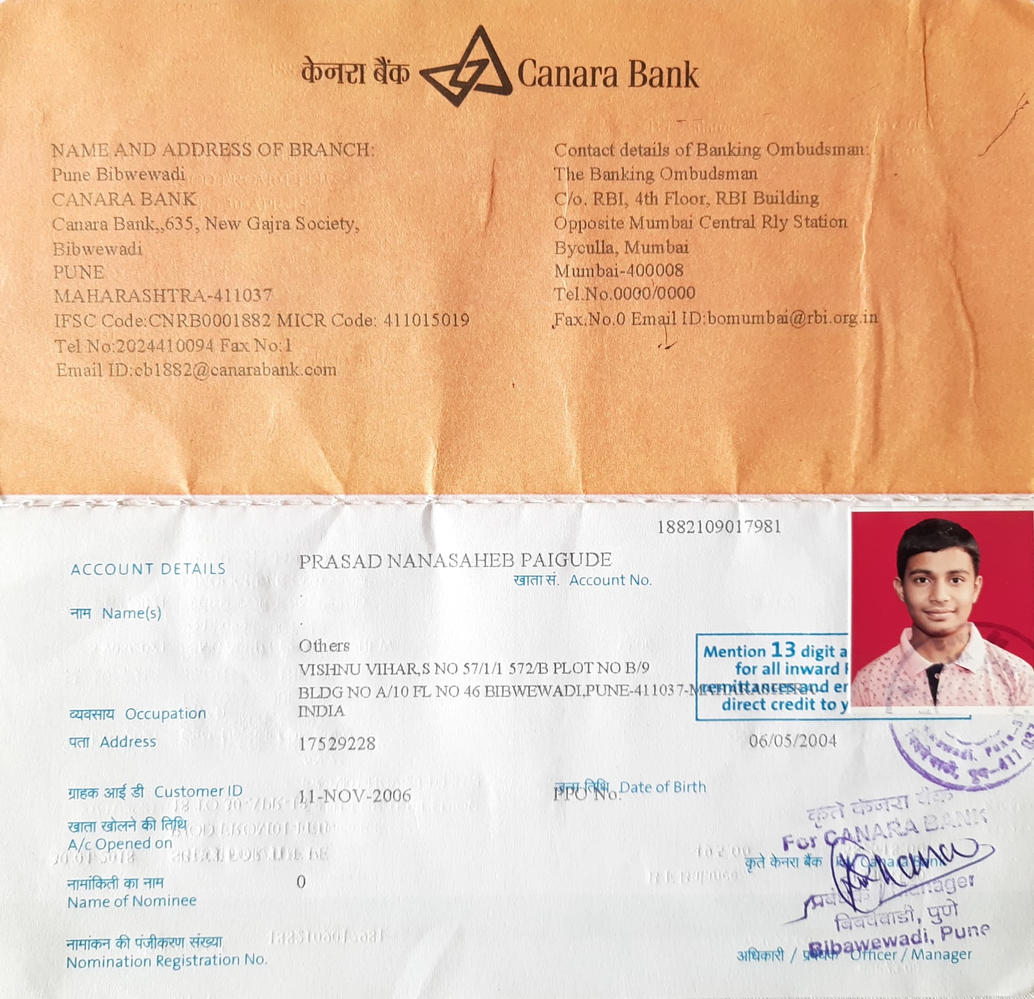
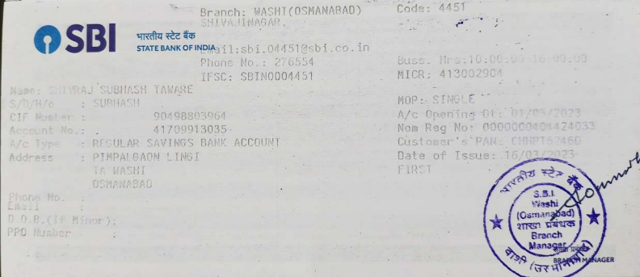
Bank Details
Full Name (as per bank records): | Bank Name | Branch Name | Account Number | Account Type (Savings / Current) | IFSC Code
Shivraj Subhash Taware | State Bank Of India | Washi, Shivaji Nagar(Osmanabad) | 41709913035 | Savings | SBIN0004451
Pragyata Ajeet Singh | Punjab National Bank | Vapi, Gujarat | 09652191023545 | Savings | ORBC0100965
Prasad Nanasaheb Paigude | Canara Bank | Pune, Bibwevadi | 1882109017981 | Savings | CNRB0001882
Team Member 1 Passbook/ Bank Statement With Name and Account Number
Team Member 2 Passbook/ Bank Statement With Name and Account Number
Team Member 3 Passbook/ Bank Statement With Name and Account Number

Slide 22
Thank You

